Slide 1
Keycloak: Going Beyond Defaults

Slide 2
Keycloak
Overview
Open-source Identity and Access Management / Single Sign-On platform
Supports protocols OpenID Connect, OAuth 2.0 and SAML
Provides features such as user management, roles and permissions, token services, multi-factor authentication, federation (LDAP, AD), social login, and identity brokering
Designed to be extensible and customizable
More info
Keycloak Server Guide

Slide 3
Before we start
Shout-Out to
How to Integrate an Identity Server with Keycloak in .NET Web APIs - Sebastian Fulga
How to authorize your .NET Web APIs using Keycloak - Catalin Popinciuc

Slide 4
1
How Keycloak Extensibility Works
2
Simple Customization
3
Advanced Customization
4
Why Keycloak?

Slide 5
Part 1
How Keycloak Extensibility Works
What is a Service Provider Interface (SPI)?
Types of SPIs

Slide 6
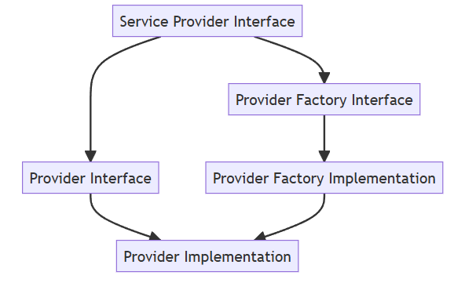
Service Provider Interface, Provider & Provider Factory
What is an SPI?
An SPI (Service Provider Interface) is a plugin contract that allows developers to:
Extend Keycloak’s behaviour
Override built-in functionality
Add new functionality that Keycloak doesn’t provide out of the box
What is a Provider?
A Provider is the implentation of an SPI, and contains the actual logic.
What is a Provider Factory?
A Provider Factory defines the configuration, initialization and lifecycle logic for a provider. It registers the provider so it becomes available as part of the system.
Types:
Authentication & Login
User Storage & Profiles
REST Endpoints
Token & Protocol Customization
Session & Storage
Identity Providers
Event Listeners
Themes & Email Templates
Import/Export & Migration
Scheduled Tasks & Utility SPIs
More info:
Keycloak Server Developer

Slide 7
What I’ve Used
Authenticator – Implements custom authentication steps within the login flow.
Action Token Handler – Processes custom action tokens carrying domain-specific information.
Required Action – Adds post-login actions (e.g., onboarding workflows or mandatory data collection).
Policy Provider – Defines custom authorization policies for advanced access-control scenarios.
Email Template Provider – Extends or overrides email templates for tailored communication.
Event Listener – Captures and processes Keycloak events for logging, auditing, or integrations.
Organization Provider – Overrides and extends logic within the Keycloak Organizations feature.
Admin Realm Resource – Adds custom admin-level REST endpoints to extend the Admin API.
Validator – Implements custom validators for user input, attributes, or form data.

Slide 8
Part 2
Simple Customization

Slide 9
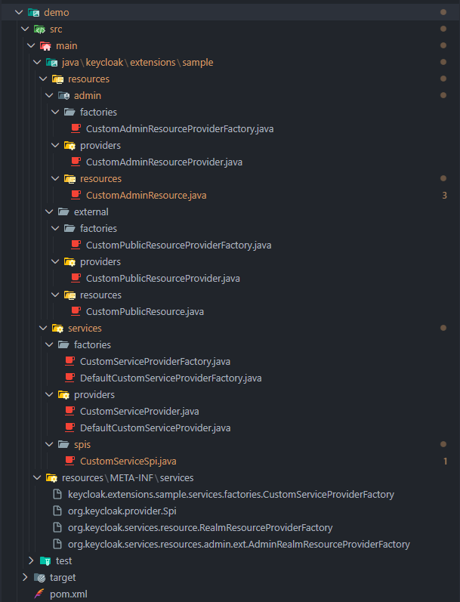
Simple Customization
What you need in order to create extensions
Create a Maven Project
Add Keycloak dependecies into pom.xml -
Typically includes keycloak-core, keycloak-server-spi, and keycloak-server-spi-private
Create the service provider registration directory -
src/main/resources/META-INF/services/
Implement the Provider Factory
Implement the Provider
Register the Provider Factory - src/main/resources/META-INF/services/<fully-qualified-factory-interface-name>
Build the JAR and place it into Keycloak’s providers/ directory
Start Keycloak so it discovers and loads the provider
Get Sample Repository

Slide 10
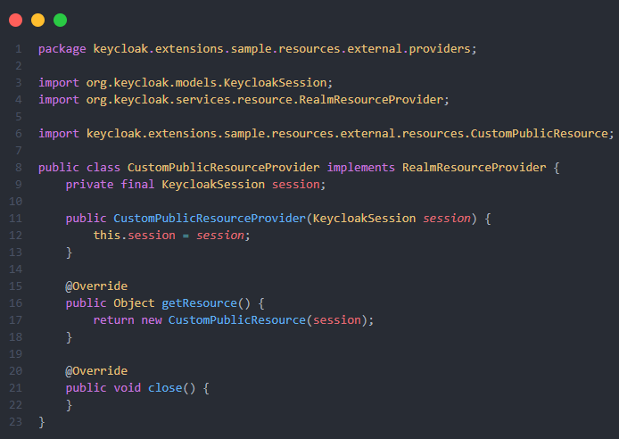
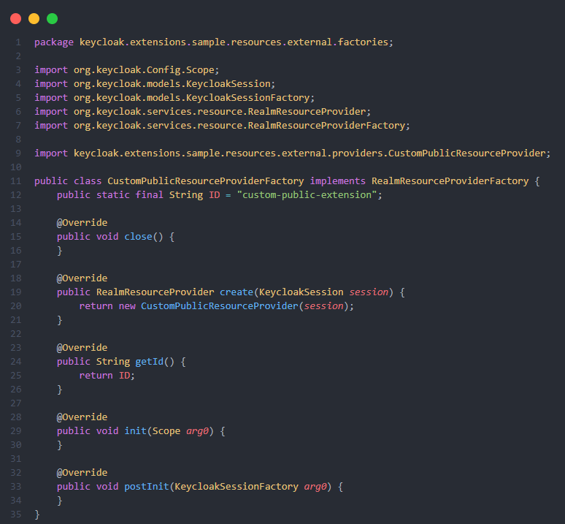
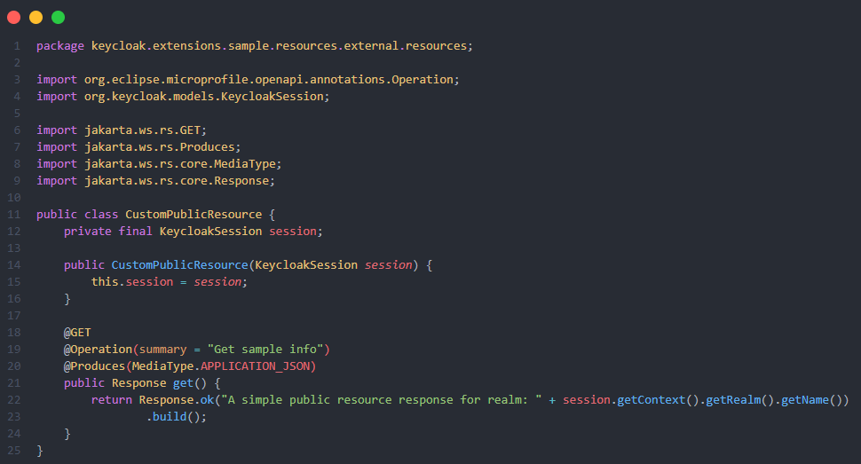
Simple Customization
Add a Public Resource (Endpoint)

Slide 11
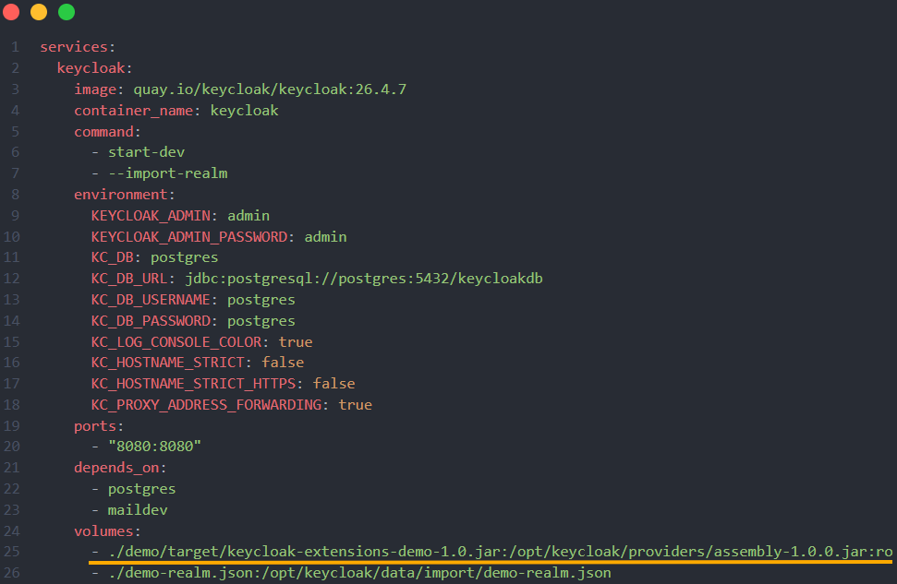
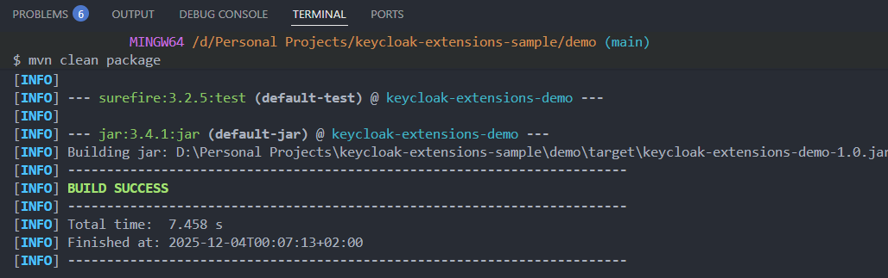
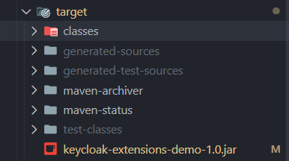
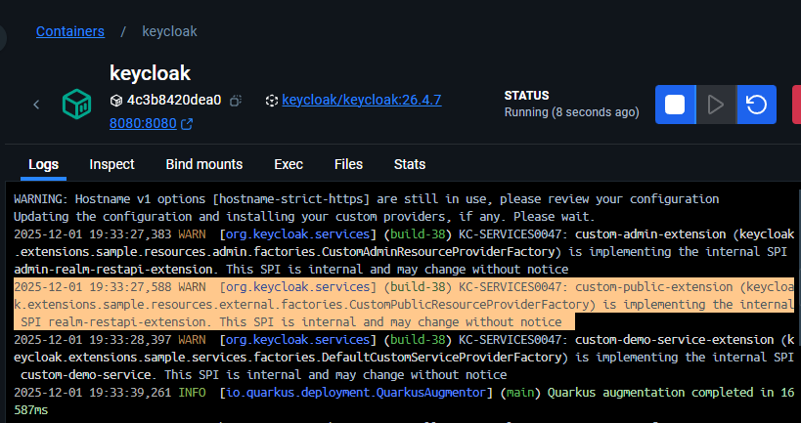
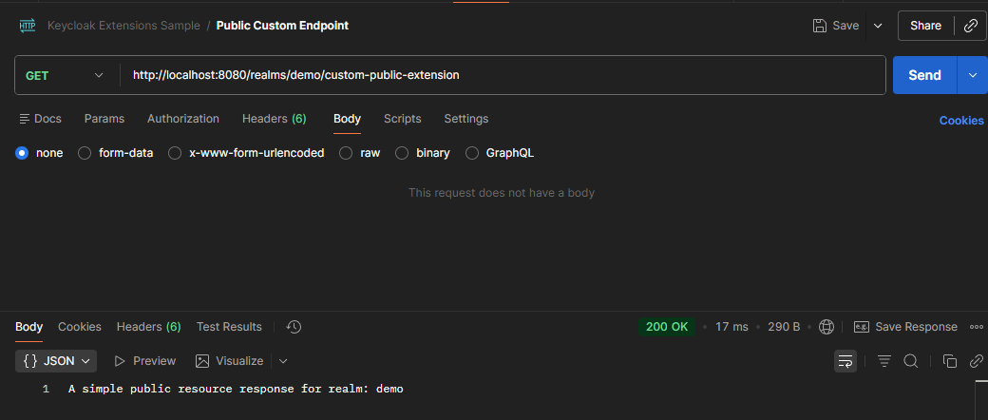
Register, Load & Test
Register the fully qualified name of the provider factory within
..\src\main\resources\META-INF\services\org.keycloak.services.resource.RealmResourceProviderFactory
Create jar and add it into /providers folder
Start keycloak, and watch for:
Test

Slide 12
Simple Customization
Demo
Public & Admin Resources
Custom Service SPI
Get Sample Repository

Slide 13
Part 3
Advanced Customization
UMA Authorization
Custom Policies
Permission Based View

Slide 14
- Story Time -
Problems to Solve
Problems
Solutions
Implement a hierarchical, single-realm multi-tenant model
A main “provider” tenant (Admin organization) manages multiple customer tenants within the same realm.
Enable fine-grained, tenant-aware authorization
Each customer tenant has its own groups, and users can hold different roles per group, depending on their tenant membership.
Ensure reusable roles with dynamically created groups
Roles are centrally defined, while groups are created on the fly and must inherit the correct permissions automatically.
Externalize authorization logic
Move permission evaluation to Keycloak Authorization Services, making the API rely on UMA-driven policies instead of internal role checks.
Customize the user onboarding flow
Provide a post-registration process tailored to the tenant context (e.g., onboarding the tenant).
Since Keycloak is not natively designed for multi-tenancy—and its “Organizations” feature is still a work in progress—several extensions were required:
1. Custom REST Endpoints
Added endpoints to extend the base Organizations feature with additional tenant-aware logic.
Implemented support for generating a tenant structure template to standardize how new tenants are created and configured.
2. Admin UI Extensions
Extended the Keycloak Admin Console to integrate tenant-scoped logic.
Enabled the use of custom authorization policies directly within the UI, including:
  organization-membership
  organization-role
  organization-group-role
  organization-group-membership
3. Custom Authorization Policies
Implemented tenant-level access control by validating:
Whether the user belongs to the target organization.
Whether the user has the correct tenant role or group role.
4. Custom Required Actions
Created required actions to enforce mandatory user tasks before account access is granted.
Example: forcing users to complete tenant onboarding details before they can continue using the system.

Slide 15
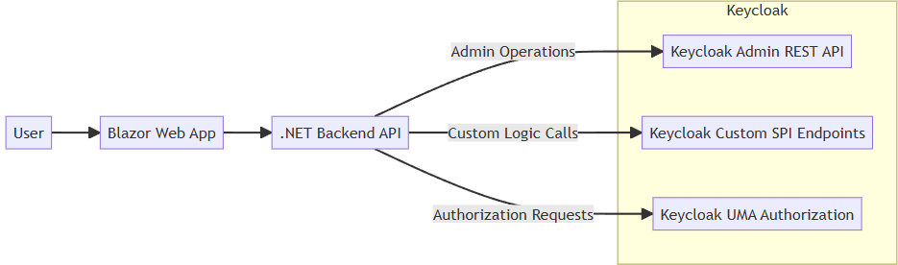
Advanced Customization
- The Plan -
A Blazor-based Admin Dashboard that integrates with Keycloak using:
Keycloak Admin REST API for user, group, and role management
Custom SPI Endpoints and Policies to extend Keycloak with additional business logic
UMA Authorization for fine-grained, per-group access control
The UI dynamically adapts based on the user’s permissions retrieved from Keycloak.

Slide 16
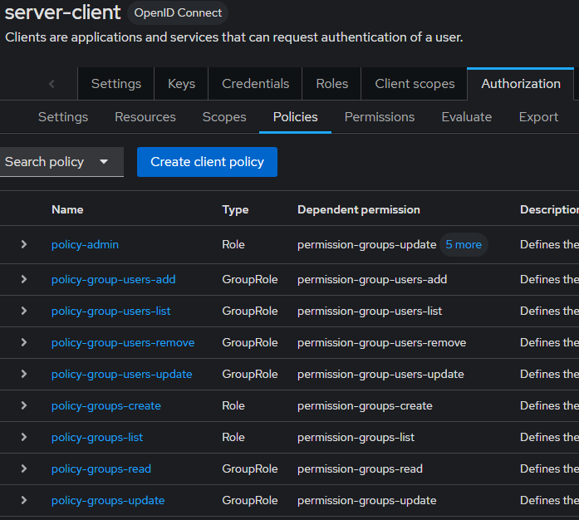
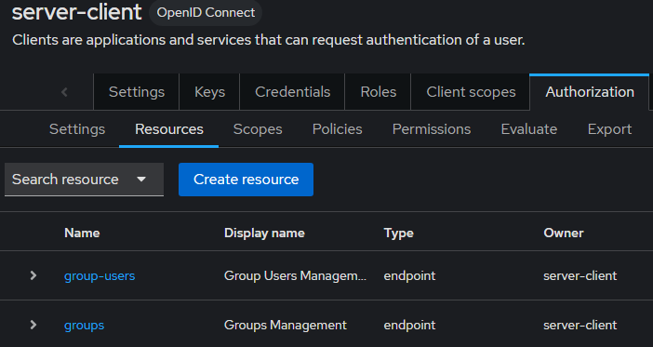
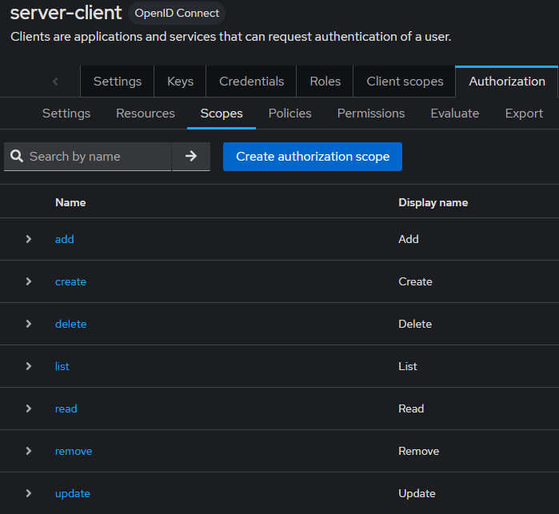
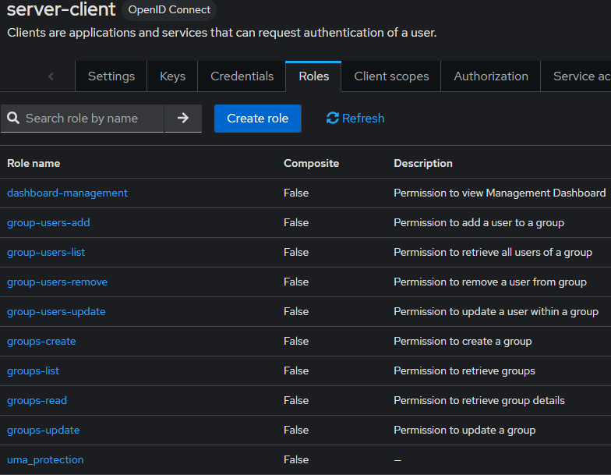
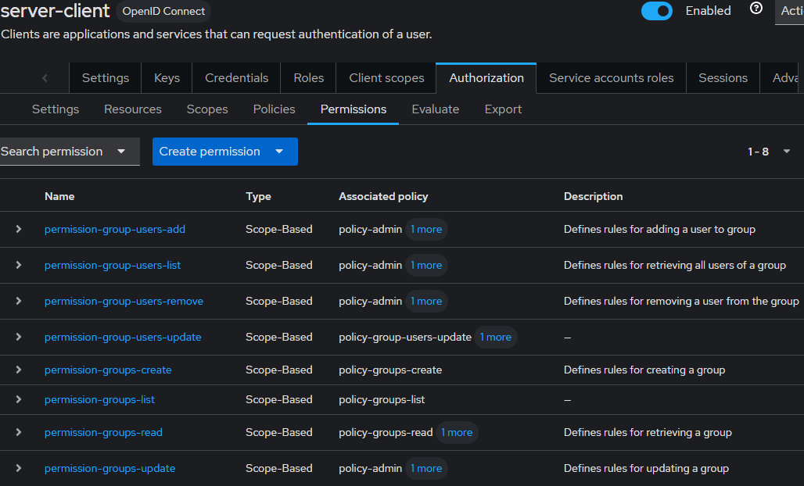
Advanced Customization
User Managed Access
& Keycloak Authorization
UMA (User-Managed Access) is an OAuth-based protocol that allows users to control who can access their protected resources across different services.

Slide 17
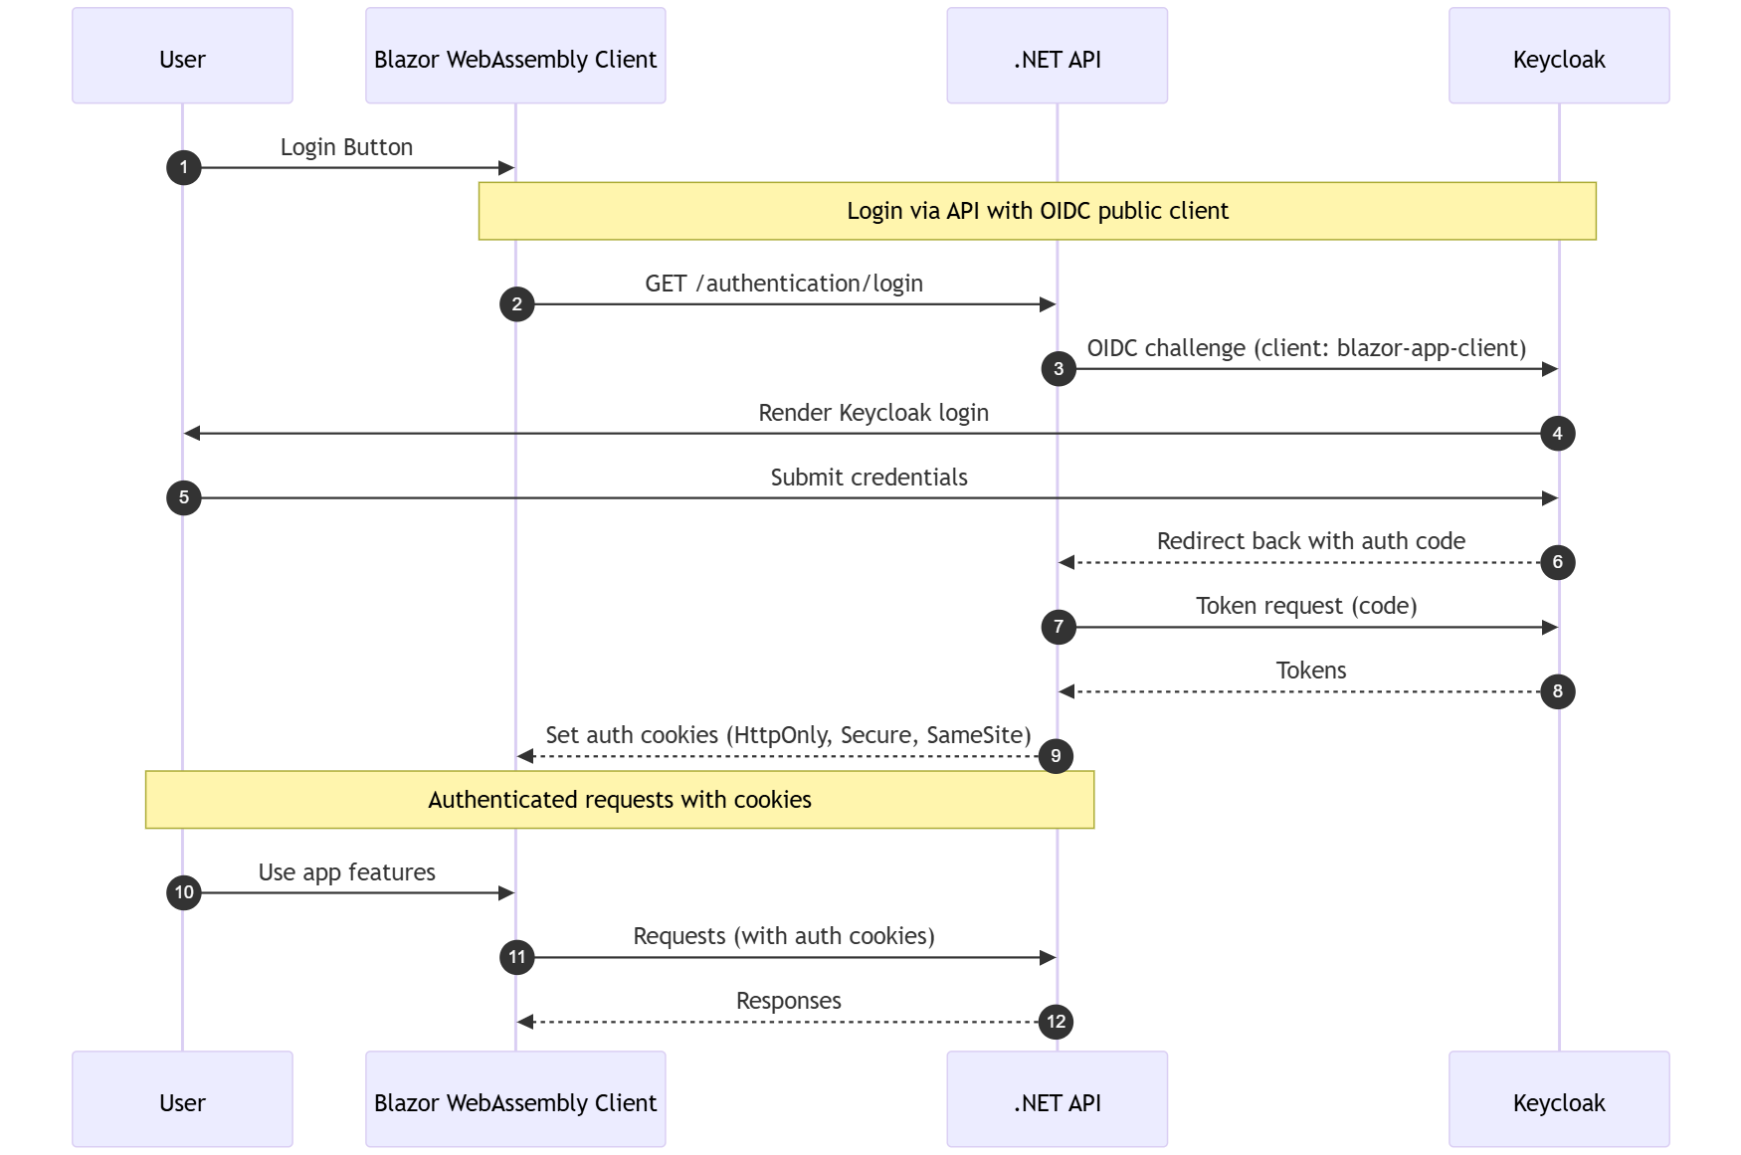
Advanced Customization
Authentication

Slide 18
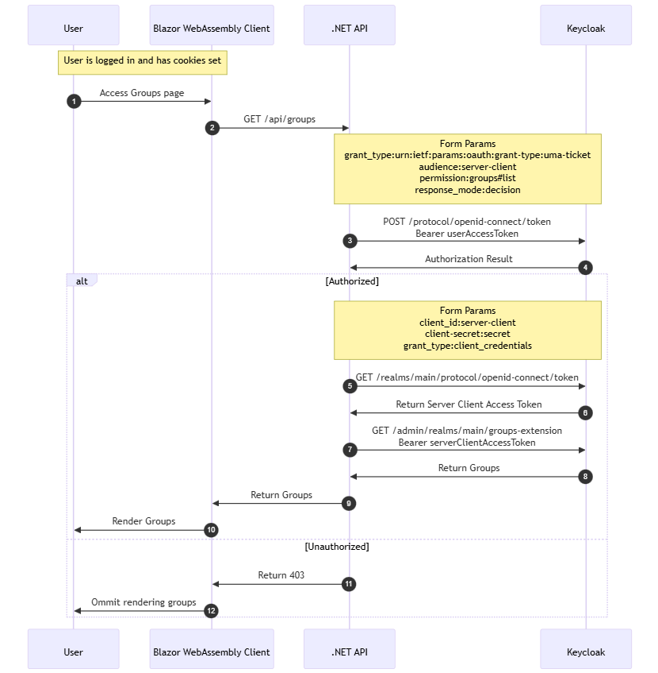
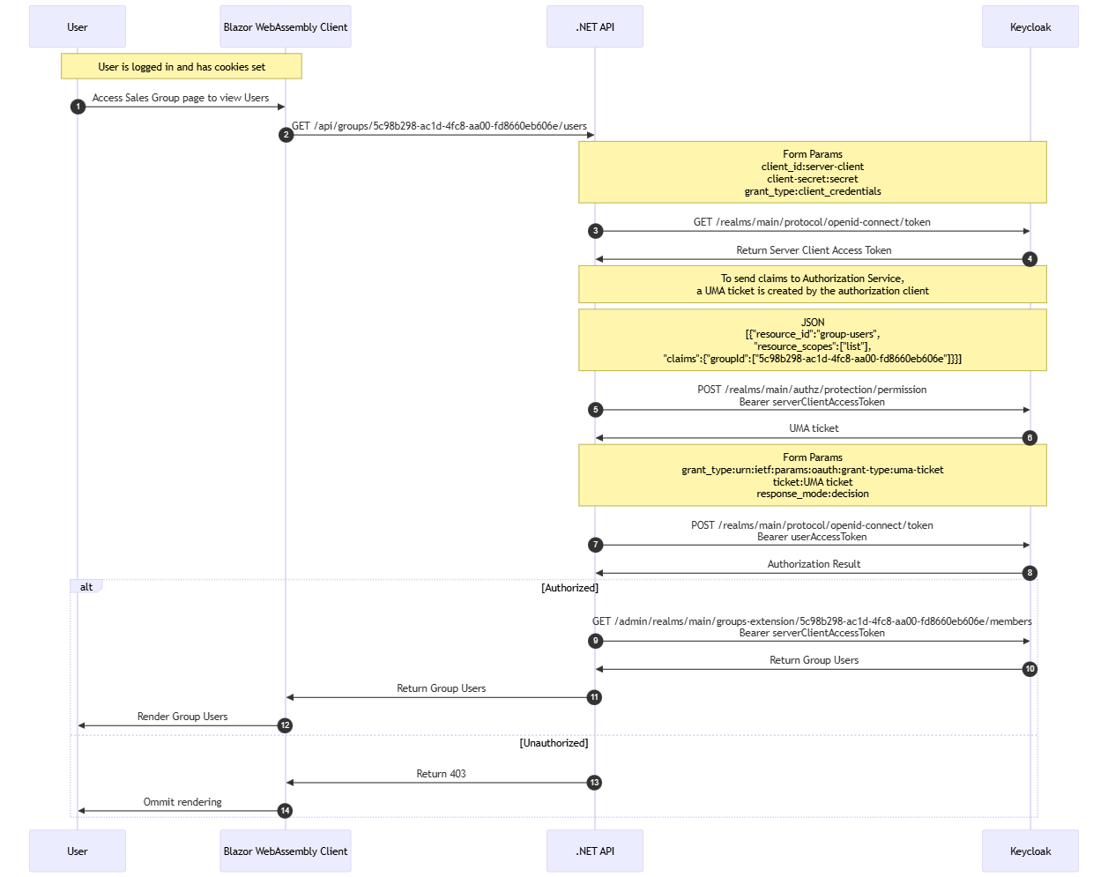
Advanced Customization
UMA Authorization Flow
UMA with claims Authorization Flow

Slide 19
Advanced Customization
Demo
Get Sample Repository

Slide 20
Part 4
Why Keycloak

Slide 21
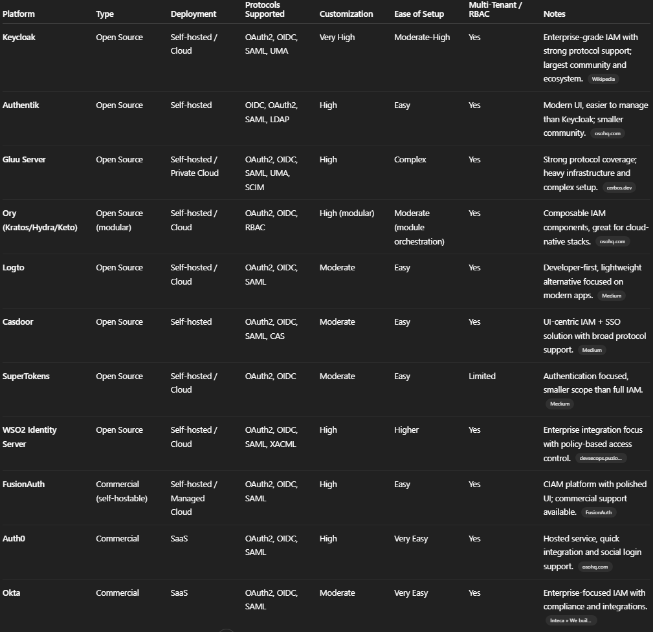
Why Keycloak

Slide 22
Why Keycloak
Strengths
Open Source – fully free to use with access to the entire codebase.
Highly Customizable – supports deep customization through SPIs, themes, custom authentication flows, and extensions.
Advanced Authorization Capabilities – robust support for fine-grained authorization, including policies, resource-based permissions, and UMA.
Self-Hosted – full control over data, security, and deployment (on-prem or any cloud).
Large Community – active global community, extensive ecosystem
Frequent Updates – regularly updated with new features, security patches, and improvements.
Weaknesses
Higher Maintenance Effort – requires operational work for upgrades, scaling, backups, and monitoring.
Complex UI and Documentation – certain parts of the admin UI and documentation can be difficult to follow for newcomers.
Feature Gaps for Specific Projects – some advanced scenarios require overriding default behavior or implementing custom extensions.

Slide 23
Extras
PhaseTwo - Enterprise implementation over Keycloak with new open source features
UMA Specification
UMA Specification 2
Extensions Demo - Niko Köbler
Keycloak Tutorials - Niko Köbler
Keycloak REST API

Slide 24
Thanks Team

